Slide 1
Lab1 - Docker intro and WS setup
Sam Liu, Allen Ou
Wifi: EE632, EE632_5G-1, EE632_5G-2
Password: quackquack

Slide 2
Outline
Ubuntu
Basic command
Vim
Docker
Jupyter Notebook

Slide 3



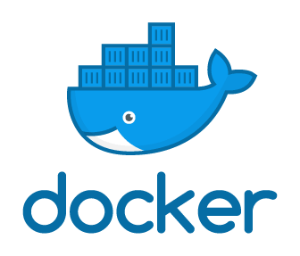

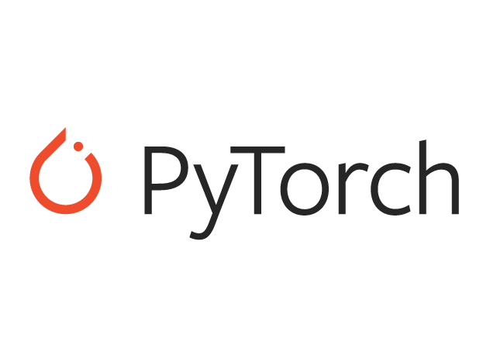

Ubuntu
Support large mount of software for system development.

Slide 4
Ubuntu
Basic command
sudo [COMMAND] | act as root before other commands (最高權限進行指令)
cd [directory] | enter a folder (進入資料夾)
ls | list all files and folders in current directory(列出該目錄所有檔案、資料夾)
mkdir [dir name] | create a folder (建立新資料夾)
cp [file] [new file] | copy files (複製檔案)
rm [file] | delete files (刪除檔案)
apt-get update | update packages (取得遠端更新伺服器的套件檔案清單)
apt-get install [package name] | install packages (安裝套件)
git clone [url of remote repository] | Git command line utility which is used to target an existing repository and create a clone, or copy of the target repository. (透過Git系統從遠端repo複製一份repo到本地端)
[COMMAND1] && [COMMAND2] | (做完COMMAND1 後 做COMMAND2)

Slide 5
Ubuntu
Vim
Common mode (Esc)
You can delete whole line, copy, and paste…
Insert mode (i)
You can type words to edit your file
Common-line mode (:)
Often for storage
:q! → 退出不儲存
:wq → 儲存並退出

Slide 6
Outline
Ubuntu
Basic command
Vim
Docker
Jupyter Notebook

Slide 7
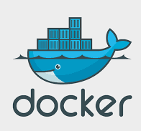
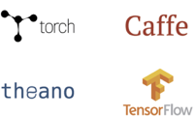
What is docker ?
Docker is a open platform to build, ship, and run distributed applications, whether on laptops, data center VMs, or the cloud.
It help us to build applications to deploy/develop our projects (for example, deep learning frameworks) quickly .
Also, docker supports several OS like Ubuntu, Mac, and Windows.
Notes:
We don’t have to worry about any package forgot to installed, or we developed a project that one computer could compile but the other one could not.

Slide 8
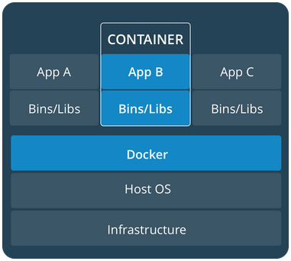
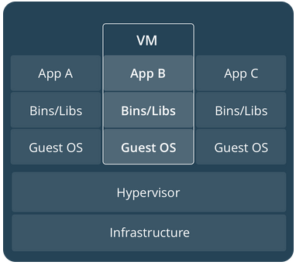
Docker Container vs. Virtual Machine
Resource
CPU, Storage, Memory,
VirtualBox
Isolation
Conflict of apt packages
Different Ubuntu versions (no mess up)
OpenCV versions
Run the same code on WS and RPi
Notes:
Containerization, also called operating-system-level virtualization is an approach for virtualization. It could simulate a process that could share all the host resources, like CPU, RAM, USB devices … , so the efficacy could almost reaches on the host. No need to use hypervisor to simulate hardware like Full Virtualization.

Slide 9
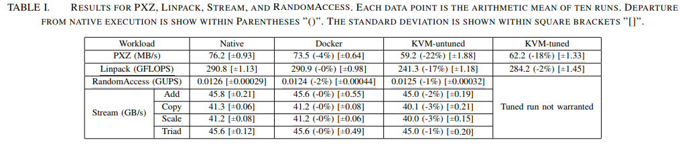
Why we use docker ?
Easy to setup Docker engine on your PC.
Deploy applications with no dependency issue brothering you.
Cloud storage called dockerhub to push/commit/pull image like github.
Run application as fast as on host environment.
2014 IBM research paper titled "An Updated Performance Comparison of Virtual Machines and Linux Containers"

Slide 10
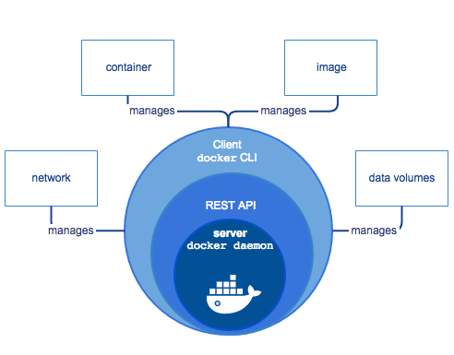
Docker engine components
A server which is a type of long-running program called a daemon process (the dockerd command).
A REST API which specifies interfaces that programs can use to talk to the daemon and instruct it what to do.
A command line interface (CLI) client (the docker command).

Slide 11
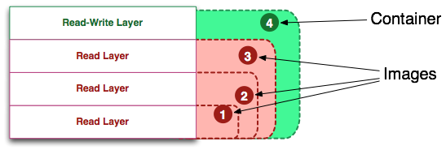
Docker image vs. container
Docker image is what your needed dependencies and your project codes stored.
Docker container is a live instance of docker image, and also add a read-write layer for saving what you done to this instance.
Notes:
if an image is a class, then a container is an instance of a class

Slide 12
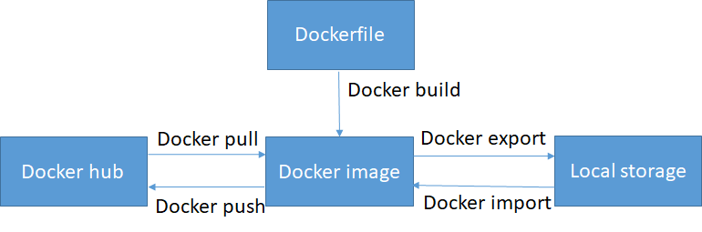
Docker CLI -- image management
docker images
docker pull
docker push
docker build
docker rmi
docker save
docker load
Docker save
Docker load

Slide 13
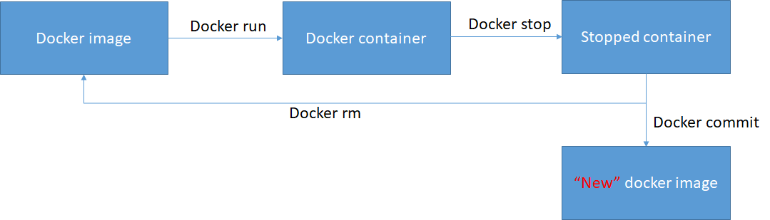
Docker CLI -- container management
docker run
docker stop
docker commit
docker exec
docker ps
docker rm
Docker start

Slide 14
Outline
Ubuntu
Basic command
Vim
Docker
Jupyter Notebook

Slide 15
Jupyter notebook

Slide 16
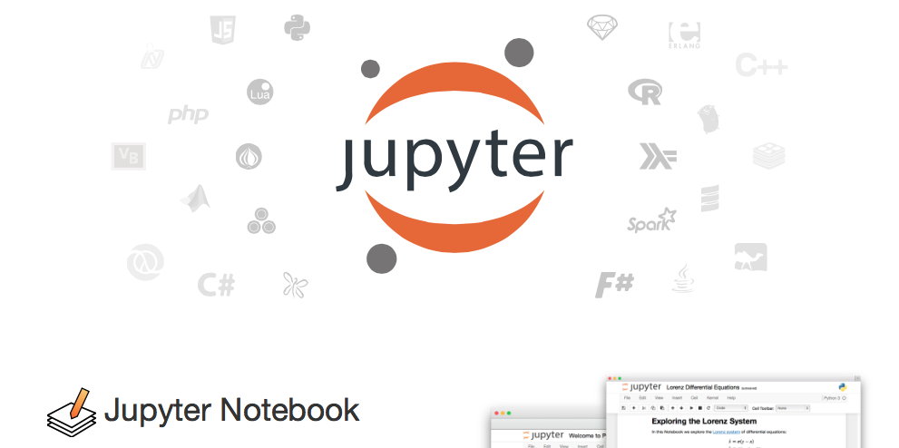
Jupyter notebook
.ipynb file
Interactive output
Python + Markdown
→ easy to edit
Server-client structure
→ launch remote jupyter server and run the notebook

Slide 17
Let’s try some examples!

